Slide 1
Network Layer:
Delivery, Forwarding, and Routing

Slide 2
DELIVERY
Delivery refers to the way a packet is handled by the underlying networks under the control of the network layers.
The delivery of a packet to its final destination is accomplished using two different methods of delivery: direct and indirect.

Slide 3
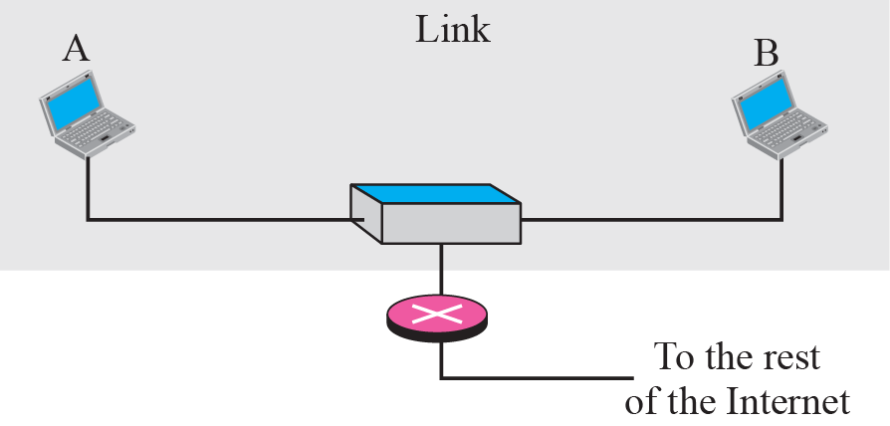
Direct delivery

Slide 4
Indirect delivery

Slide 5
FORWARDING
Forwarding refers to the way a packet is delivered to the next station
Forwarding requires a host or a router to have a routing table.
Routing refers the way routing table are created to help in forwarding
Several techniques can make the size of the routing table
Next hop method vs route method
Network specific method vs host specific method
Default method

Slide 6
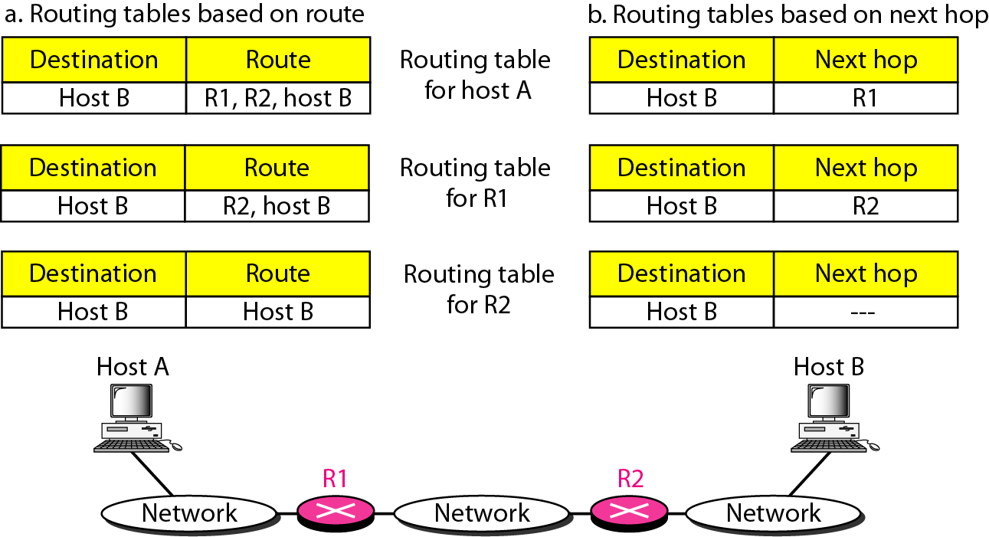
Figure Route method versus next-hop method
In next-hop routing, Routing table holds the information (IP address) that leads to the next hop (router) instead of holding information about the complete path

Slide 7
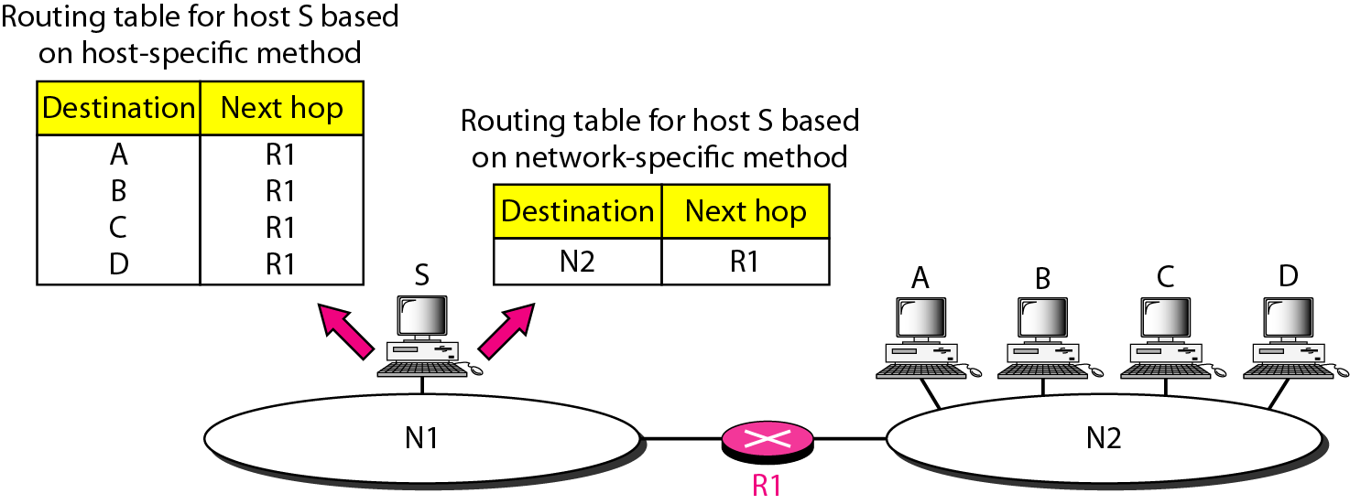
Figure Host-specific versus network-specific method
Instead of having entry for each host connected to the same network, the table contains only a single entry for the address of the network itself

Slide 8
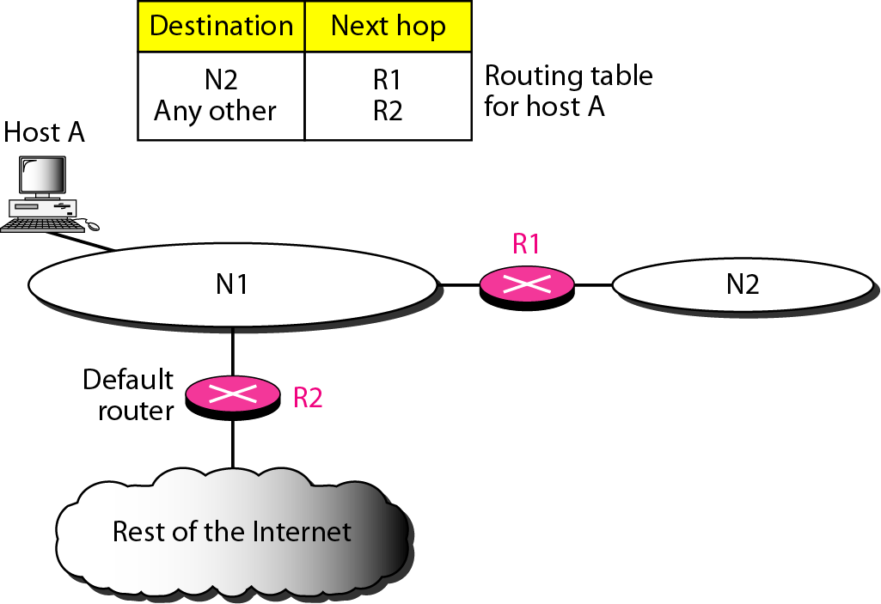
Figure Default method
Default router is used if the destination network address is not found in the routing table

Slide 9
Routing (IP routing)
Routing Protocol: determines the best path (route) that the packets should follow to arrive to the desired destination
Routing Protocols: A software in the network layer that implements routing algorithms and responsible for:
Filling and updating routing tables (by finding the shortest paths from each source to each destination) This part is called Routing
Deciding which output interface an incoming packet should be transmitted on (by referring to the routing table). This part is called Forwarding

Slide 10
Routing Algorithms Classifications
Static
Information entered manually
Shortest paths are precompiled offline by a special computer running the routing algorithm
Resulted information is entered manually by the administrator into the routing tables
Can not update automatically if there is a change in the network or failure
Used in small networks
Dynamic (adaptive)
Each router or host learns the state of the network by communicating with its neighbours.
Based on the collected information, each node can fill its routing table
More complexity is added to the router

Slide 11
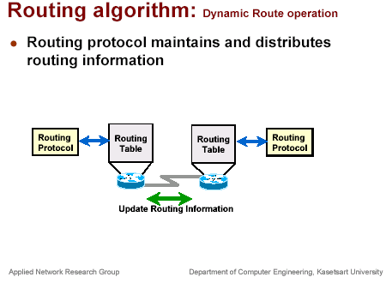

Slide 12
Shortest Path Routing
Algorithms used to determine the shortest path between two nodes according to some cost condition.
The shortest path is the path with the least cost (the sum of the cost of the links on the path is minimum over all possible paths between the source and destination)
Two main algorithms to find the shortest path between any two nodes
Distance Vector (Bellman-Ford Algorithm )
Link State – (Dijkstra’s Algorithm)

Slide 13
Distance Vector (DV) Routing
The distance vector routing algorithm, also called a Bellman-Ford algorithm after two of its inventors, is one where routes are selected based on the distance between networks.
Basic idea: each network node maintains a Distance Vector (DV) table containing the distances from itself to ALL possible destination nodes.
Distances are based on a chosen metric (Metric: usually number of hops, bandwidth, delay)
Router transmits its distance vector table to each of its neighbors (directly connected to it) periodically (every 30 sec)
A router recalculates its distance vector when:
It receives a distance vector table from a neighbor containing different information than before.
It discovers that a link to a neighbor has gone down or up (i.e., a topology changes).
Distances to all destinations are computed using information from the neighbors’ distance vectors.
The DV calculation is based on minimizing the cost to each destination.
From its DV, a router can directly derive its routing table.

Slide 14
Bellman-Ford Algorithm
3
 | S | A | B | C | D
Initial | 0 | ∞ | ∞ | ∞ | ∞
1 | 0 | 1 | 6 | 7 | 7
2 | 0 | 1 | 6 | 4 | 6
3 | 0 | 1 | 6 | 4 | 6
4 | 0 | 1 | 6 | 4 | 6
4
A
C
S
-5
2
6
B
D
1
Edges: SA, SB, AC, BA, BD, CD
Number of Iteration: V-1 =5-1= 4
Shortest Path tree:
S -> B -> A -> C ->D
Distance vector protocols example: RIP (Routing Information Protocol),
EIGRP (Enhanced Interior Gateway Routing Protocol)
RIP follows Bellman-Ford Algorithm
EIGRP follows Diffusing Update Algorithm (DUAL)

Slide 15
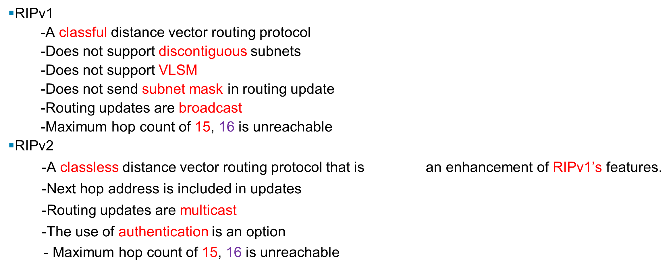
Routing Information Protocol

Slide 16
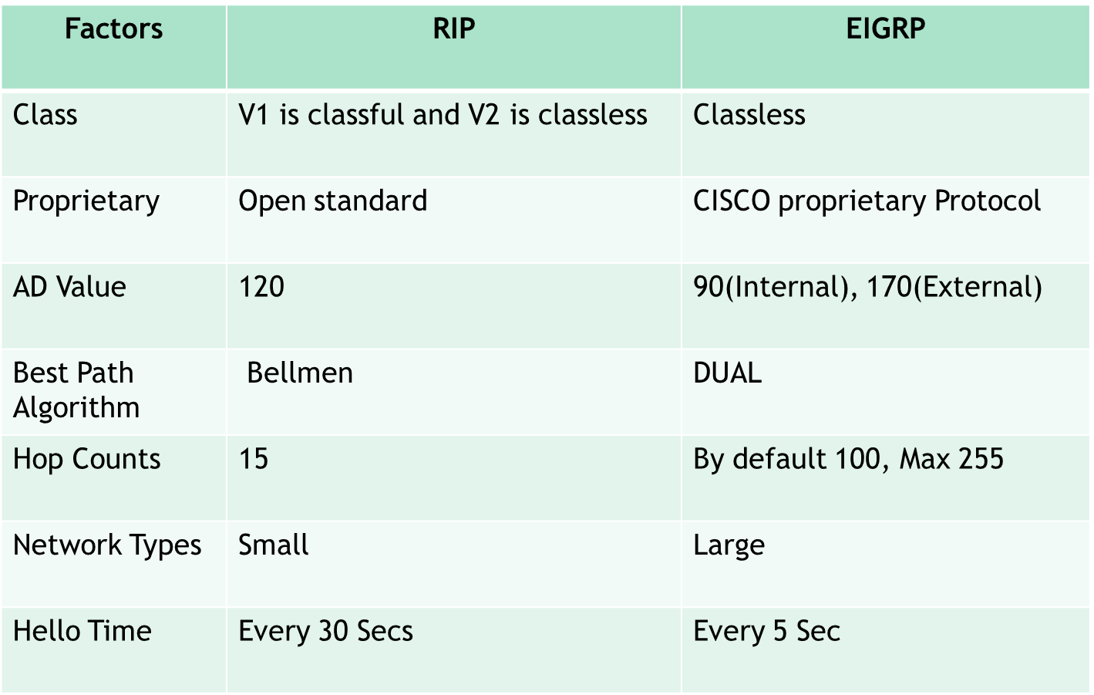
RIP Vs EIGRP

Slide 17
Link State Routing
Each router measures the cost (in delay, Bandwidth) between itself and its neighbour routers (directly connected)
The router builds a packet containing all these costs.
Each router distributes these packets using flooding to ALL other routers in the routing area
Information is sent when there a change in the link between the router and its neighbours (to reduce traffic)
Each router builds map of the entire network, uses a shortest-path algorithm (usually Dijkstra algorithm) to compute a shortest path between itself and any other node in the area (creates the routing table)
OSPF (Open Shortest Path first is an Example)

Slide 18
Comparison between distance vector & Link state
Distance Vector Routing | Link State Routing
Bandwidth required is less due to local sharing, small packets and no flooding. | Bandwidth required is more due to flooding and sending of large link state packets.
Based on local knowledge, since it updates table based on information from neighbors. | Based on global knowledge, it have knowledge about entire network.
Make use of Bellman Ford Algorithm. | Make use of Dijakstra's algorithm.
Traffic is less. | Traffic is more.
Converges slowly, good news spread fast and bad news spread slowly. | Converges faster.
Count of infinity problem. | No count of infinity problem.
Practical implementation is RIP | Practical implementation is OSPF

Slide 19
Autonomous systems (AS)
On the Internet, Autonomous system (AS) is either a single network or a group of networks that is controlled by a common network administrator
An autonomous system is assigned a globally unique number, sometimes called an Autonomous System Number (ASN).
AS systems are connected by special routers called boarder routers or gateways routers.
Routers in same AS run same routing protocol this is called “intra-AS” (interior) routing protocol
Routing between autonomous systems is called inter-AS or exterior routing
Gateways routers (boarder routers) are special routers in AS that run intra-AS” routing protocol and also responsible for routing to destinations outside AS by running inter-AS (exterior) routing protocol with other gateway (boarder) routers

Slide 20
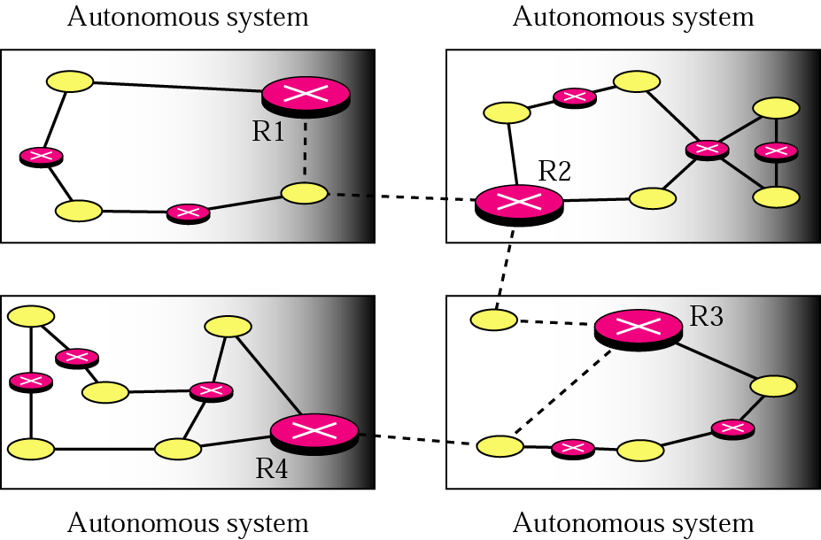
Figure 21.3 Autonomous systems
Routers R1,R2,R3,R4 are designated as border gateway routers
These routers run both interior and exterior routing protocols

Slide 21
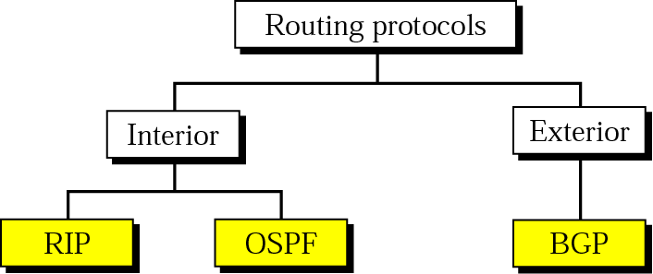
Figure 21.2 Popular routing protocols
Interior routing (RIP, OSPF): between routers inside a single AS
Exterior routing (BGP): between routers connecting several AS
BGP stands for Border Gateway Protocol Routing

